Slide 1
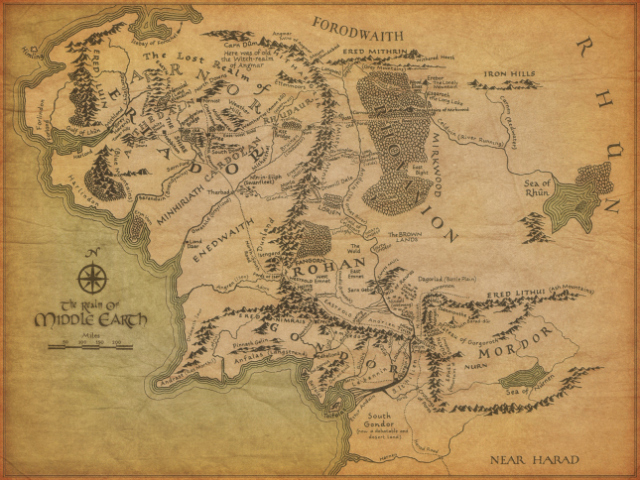

The Fellowship of the Ring Personal Leadership Towards Joyful Work
With Joe Schmetzer & Portia Tung

Slide 2

Which character do you most identify with and why?
Notes:
Take a couple of minutes.
In pairs, take turns sharing your miracle and notes for one another.

Slide 3

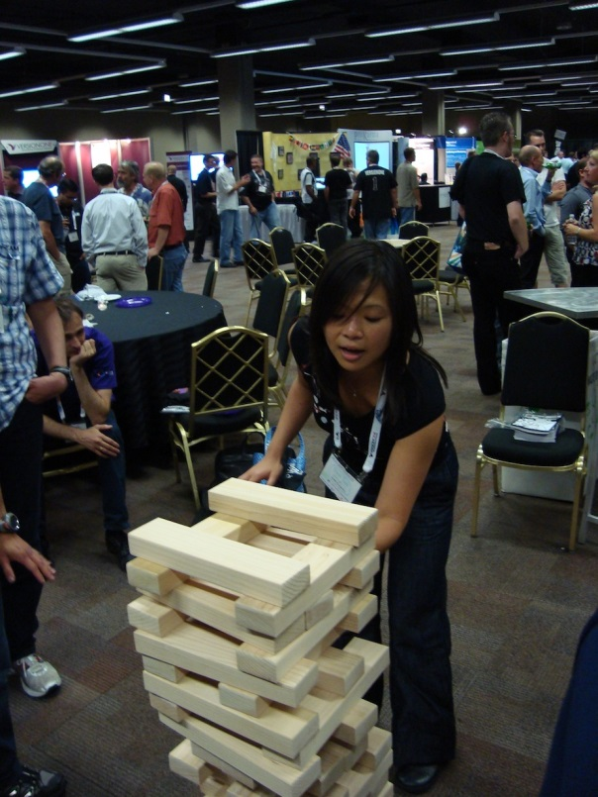
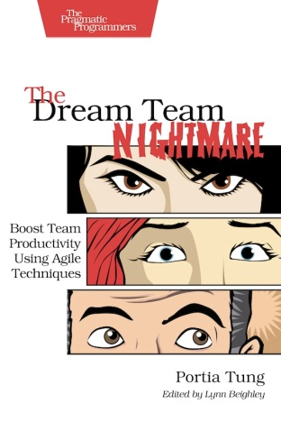
About Us
Joe Schmetzer
Portia Tung
Renaissance Developer Generalising specialist Coach
Agile Coach Playmaker
Enterprise Gardener
Blog: http://www.exubero.com/
Twitter: tumbarumba
Blog: www.selfishprogramming.org
Twitter: portiatung

Slide 4
Joyful Work
To make work joyful
As aspiring leaders
We need to practice personal leadership.
Success Criteria
[ ] I know what the Mutual Learning Model is
[ ] I know what the 8 behaviours are
[ ] I’ve gained one or more personal insights
[ ] I've identified at least one personal improvement action
[ ] We've had fun!

Slide 5
The Espoused Mindset Questionnaire
Read each pair of statements. For each pair, tick the box which most accurately reflects the way you think.
For instance, tick "1" if you fully agree with the statement on the left or tick "4" if you fully agree with the statement on the right.
 | 1 | 2 | 3 | 4
1) I understand situation better than anyone else in my team |  |  |  |  | 1) I have information and others do, too
2) People who disagree with me are pushing an agenda |  |  |  |  | 2) People who disagree with me are trying to help me
3) I am right most of the time |  |  |  |  | 3) I am often mistaken or have incomplete knowledge
4) I don't have much to learn from my colleagues |  |  |  |  | 4) I can learn from our differences
5) My feelings are obvious and justified |  |  |  |  | 5) My feelings are not obvious to others and may not be rational
6) I never cause problems in my team |  |  |  |  | 6) I may be part of the problem
Questionnaire designed by Joe Schmetzer & Portia Tung
Derived from Chris Argyris’s Mutual Learning Model
Notes:
Add up the rating numbers you have ticked.
Keep these numbers safe as we’ll need them later.

Slide 6
The Mutual Learning Scale
1 = Definitely false 2 = Mostly false 3 = Mostly true 4 = Definitely true
__ 1) I have information and others do, too.
__ 2) Each of us sees things others don't.
__ 3) People may disagree with me but still have pure motives.
__ 4) Differences are opportunities for learning.
__ 5) It's possible I may be part of the problem.
__ 6) I state views and ask genuine questions.
__ 7) I share all relevant information.
__ 8) I use specific examples and agree on what important words mean.
__ 9) I explain my reasoning and intent.
__ 10) I focus on interests not positions.
__ 11) I test assumptions and inferences.
__ 12) I jointly design next steps.
__ 13) I discuss undiscussable issues.
Scale design by Portia Tung & Joe Schmetzer
Derived from Chris Argyris’s Mutual Learning Model and “Smart Leaders Smarter Teams” by Roger Schwarz
Notes:
This is the Mutual Learning Scale.
Next to each numbered statement, note down either 1, 2, 3, 4 depending on how true each statement applies to you.
When you’ve completed the scale, raise your hand to help us pace the exercise.
[Everyone or majority of people has raised their hand]
Now it’s time for a bit of mental arithmetic.
First, add up your ratings for all 13 statements.
Next, add up your ratings for the first 5 statements.
Last, add up your ratings for the remaining 8 statements.
Keep the 3 numbers safe. We’re going to come back to them shortly.

Slide 7
Prologue
A release must be ready for next week's trade show.
Three key players are meeting to discuss the progress of the release.
Notes:
Give out large wearable nameplates to actors.
Give Values and Assumptions to actors.
Give Behaviours sheet to audience members.
Get observations on results from audience members.

Slide 8
Act I Scene I
The weekly project progress meeting.
Enter the product owner, project manager and team lead.
Notes:
Hand out large wearable nameplates for actors.
Give Model 1 Values and Assumptions cue cards to actors.
Give Model 1 Behaviours bingo sheet to audience members.

Slide 9
Reflection
What did you see and hear?
What were the goals of each character?
Who has meetings mostly like this one?

Slide 10
Model I
Mindset
Behaviours
Values
Win, don’t lose
Be right
Minimise expressions of negative feelings
Act rational
Assumptions
I understand the situation; those who disagree don’t
I am right; those who disagree are wrong
I have pure motives; those who disagree have questionable motives
My feelings and behaviour are justified
I am not contributing to the problem
State my views without asking for others’ views and vice versa
Withhold relevant information
Speak in general terms and don’t agree on what important words mean
Keep my reasoning private; don’t ask others about their reasoning
Focus on positions, not interests
Act on untested assumptions and inference as if they were true
Control the conversation
Avoid, ease into, or save face on difficult issues
Results
Performance
Lower-quality decisions
Less innovation
Longer implementation time
Increased costs
Individual Well-Being
Reduced motivation
Decreased satisfaction
Limited development opportunities
Increased stress
Working Relationships
Lower commitment
Decreased trust
Reduced learning
Greater defensiveness
Unproductive conflict
Inappropriate dependence on others
The Vicious Cycle of Unilateral Control by Roger Schwarz

Slide 11
Act II Scene I
The weekly project progress meeting.
Enter the product owner, project manager and team lead.
Notes:
Hand out large wearable nameplates for actors.
Give Model 2 Values and Assumptions cue cards to actors.
Give Model 2 Behaviours bingo sheet to audience members.

Slide 12
Reflection
What did you see and hear?
What were the goals of each character?
Who has been to a meeting like this?
Who wants their meetings to be more like this one?

Slide 13
Model II
Mindset
Behaviours
Values
Transparency
Curiosity
Informed choice
Accountability
Compassion
Assumptions
I have information; so do other people
Each of us sees things others don’t
People may disagree with me and still have pure motives
Differences are opportunities for learning
I may be contributing to the problem
State views and ask genuine questions
Share all relevant information
Use specific examples and agree on what important words mean
Explain reasoning and intent
Focus on interests, not positions
Test assumptions and inferences
Jointly design next steps
Discuss undiscussable issues
Results
Performance
Higher-quality decisions
Greater innovation
Shorter implementation time
Reduced costs
Individual Well-Being
Increased motivation
Increased satisfaction
Richer development opportunities
Reduced stress
Working Relationships
Greater commitment
Increased trust
Increased learning
Reduced defensiveness
Productive conflict
Appropriate dependence on others
The Virtuous Cycle of Mutual Learning by Roger Schwarz
Notes:
The Mutual Learning approach draws from Chris Argyris and Don Schön’s Model II work, as well as the work of Bob Putnam, Diana Smith and Phil MacArthur at Action Design, who originally used the term Mutual Learning Model.
Combine Chris Argyris's Model 1: Unilateral Control vs Model 2: Mutual Learning Model
- What people say they think – espoused theory
- What people are observed doing – theory in use
- Observable behaviour reveals discrepancy between espoused theory and theory in use
With Schwarz's 8 Behaviours for Smarter Teams
- If you learn and practice these behaviours (aka skills), your theory in use can transition from Model 1 to Model 2.
- Fundamentally, it's important to change your mindset in order to change behaviour to have long-term results.
The Metaphor:
Your mindset = Operating system (Windows)
Your behaviours = Application software (eg Word)

Slide 14
What’s your espoused leadership mindset?
Model I:
6 points = Fully Model I
12 points = Mostly Model I
Model II:
18 points = Mostly Model II
24 points = Fully Model II
15 points = Balanced
 | 1 | 2 | 3 | 4
1) I understand situation better than anyone else in my team |  |  |  |  | 1) I have information and others do, too
2) I am right most of the time |  |  |  |  | 2) People who disagree with me are trying to help me
3) People who disagree with me are pushing an agenda |  |  |  |  | 3) Other can teach me much
4) I can teach people to fix their mistakes |  |  |  |  | 4) I can learn from our differences
5) My feelings are obvious and justified |  |  |  |  | 5) My feelings are hidden and may be self-motivated
6) I never cause problems in my team |  |  |  |  | 6) I may be part of the problem
Questionnaire designed by Joe Schmetzer & Portia Tung
Derived from Chris Argyris’s Mutual Learning Model
Notes:
What your score means:
6 = Fully Model 1
12 = Mostly Model 1
15 = Congruent
18 = Mostly Model 2
24 = Fully Model 2

Slide 15
The Model I –Model II Quadrant
Observed Behaviours
Model I Values
Model II Behaviour
Empathic Self-Deception
Model II Values
Model II Behaviour
Empathic & Collaborative
Model II
Model I Values
Model I Behaviour
Rational & Controlling
Model II Values
Model I Behaviour
Perverse Self-Deception
Model I
Espoused Mindset
Model I
Model II
Quadrant designed by Joe Schmetzer & Portia Tung
Partly-derived from and inspired by Chris Argyris’s Mutual Learning Model

Slide 16
What’s your leadership preference?
32
Mutual Learning
Weak Mutual Learning mindset; rarely applies it
Applies Mutual Learning behaviours most of the time
24
x
x
Mutual Learning Bias
Congruent in mindset and behaviour most of the time
Regularly gets desired results from Virtuous Mutual Learning cycle
16
x
Claims to have strong Mutual Learning mindset
Occasionally apply behaviours in practice
B e h a v i o u r
Unilateral Control Bias
8
Unilateral Control
0
5
10
15
20
M i n d s e t
Hypothetical results mapping by Portia Tung & Joe Schmetzer
Notes:
Hypothesis can be proven by comparing expected results from Virtual Cycle of Mutual Learning.
About the Mutual Learning Scale:
The first 5 statements are the assumptions from Chris Argyris’s Mutual Learning Mindset
The next 8 statements are the behaviours from Schwarz.
How does the scoring work?
Score for mindset range from:
5 = Don’t apply values
10 = Rarely apply values
15 = Mostly apply values
20 = Always apply values
Score for behaviours range from:
8 = Don’t apply behaviours
16 = Rarely apply behaviours
24 = Mostly apply behaviours
32 = Always apply behaviours
Maximum congruence scores:
13 = 100% UC
26 = Mostly UC
39 = Mostly ML
52 = 100% ML
So how did you score on the Mutual Learning Scale?
If you scored a total of 52 points, stand up. This is the highest possible score on the scale and means you’re congruent in your espoused theory and theory in practice.
You believe in your ML talk AND you talk the talk and walk the walk all the time.
Let’s drill down into the significance of more results by looking at time in pairs: mindset and behaviours.
On the one hand, if you scored 20 points for questions 1-5, you score yourself maximum on ML mindset and:
For questions 6-13:
If you scored 24 or higher, this means your preference is mostly ML. You believe in your ML talk AND you can talk the talk and do walk the walk most of the time.
If you scored 16-23, your behaviour straddles between UC and ML. You believe in your ML talk AND you fluctuate between UC and ML in behaviour.
If you scored 8-15, your belief in ML is in strong contradiction with your predominantly UC behaviour.
On the other hand, if you scored between 5 and 10 for questions 1-5, you believe in UC AND you talk the talk and walk the walk all the time.
So – why did I ask you to share your score?
The main reason is to create the option for you to find the practitioners of ML during the break and get tips on how to live and breathe the Mutual Learning Model and 8 behaviours, even under stress.
Thank you. Everyone take a sit.
Let’s look at the findings in greater detail. If you scored 15 for mindset and 24 for behaviour, it means you are congruent in applying Mutual learning most of the time. The results you get from your efforts should reflect this.
If you scored higher in behaviour than mindset, it means you actively apply the Mutual Learning behaviours without really applying the mindset. You talk the talk and walk the walk but you don’t quite believe in the ML mindset. Nonetheless, starting to change your behaviour can be an easier way to changing your mindset. As Amy Cuddy, psychologist famous for her Ted talk on the Power Pose and the body influencing the mind, it’s about "Fake it until you become it."
If you scored higher in mindset than behaviour, it means that you believe strongly in the Mutual Learning mindset yet don’t apply the behaviours fully in practice all of the time. This is a strong position to be in, however, belief needs to result in corresponding behaviour to be effective. Monitor your theory in practice for discrepancies to your ML mindset to increase your practice of ML behaviour more often, especially when under stress.
How accurate is the Mutual Learning Scale?
It depends. We suggest taking your two scores and multiplying them by 3/5 each to calbrate it for how you think and act under stress.
For instance, if Annie scores 20/20 for mindset on a sunny day, under stress, she would more likely score 15/20.
For instance, if Annie scores 25/32 for mindset on a sunny day, under stress, she would more likely score 15/32.
What we expect to see is a reduction by one level down, from “competent” to “advanced beginner” when Annie is under stress. Embedding Mutual Learning as a mindset is vital to ensure your best chances of congruent behaviour to get the desired results.

Slide 17
Your Turn
In pairs:
Where are you on the quadrant?
Where would you like to be?
Identify at least one personal improvement action to move towards your target location

Slide 18
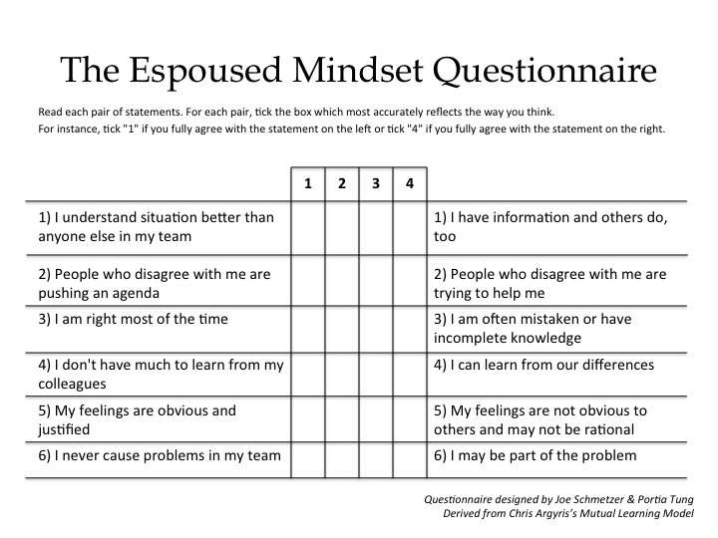
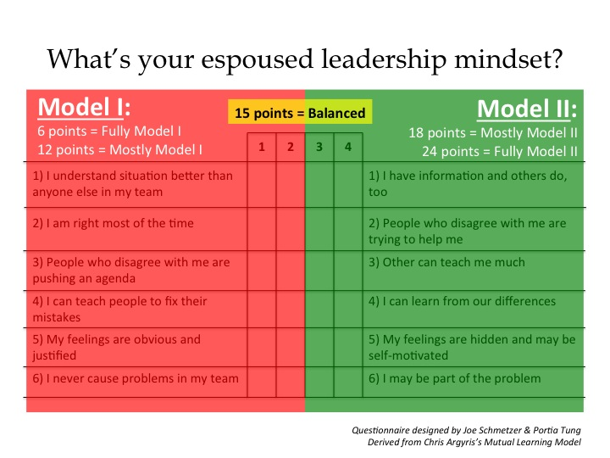
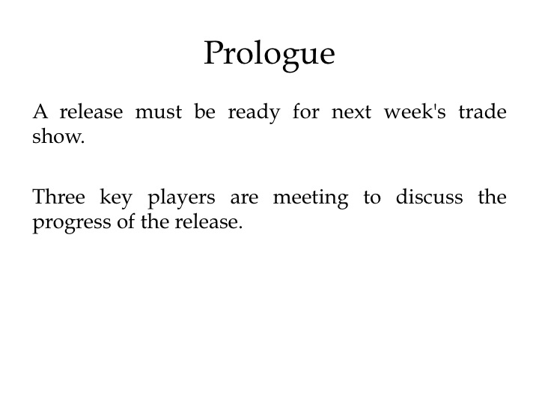
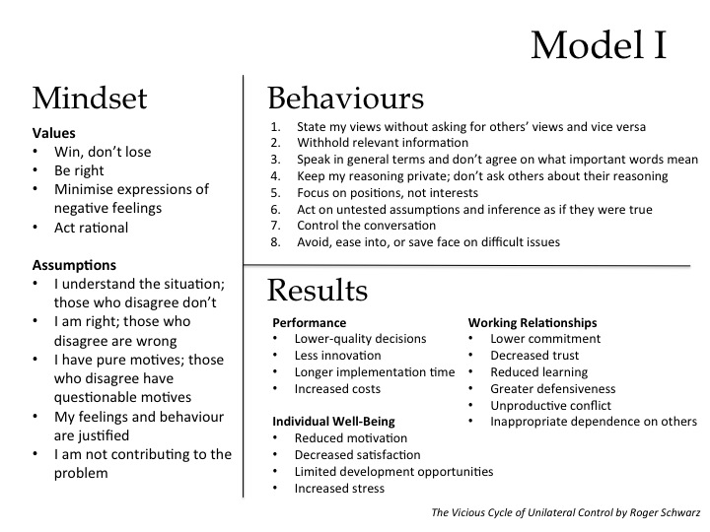
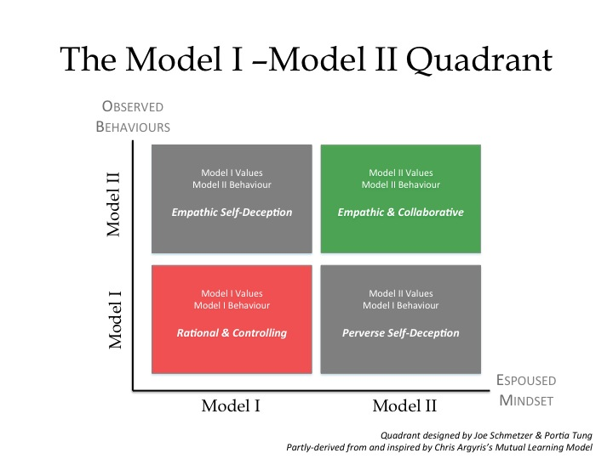
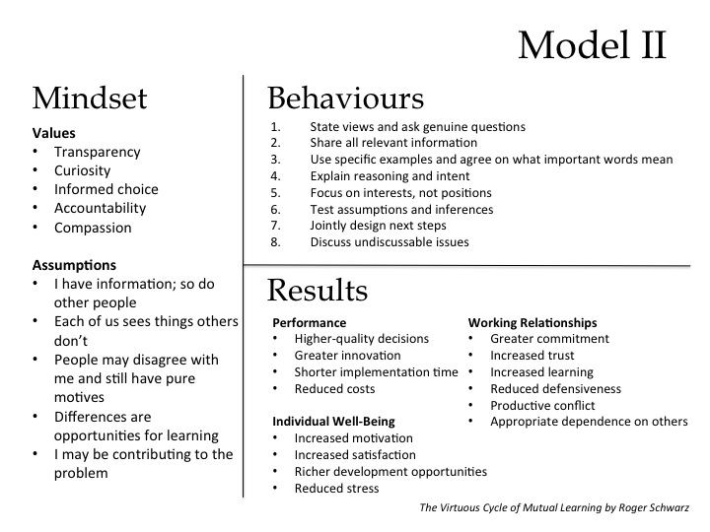
Summary

Slide 19
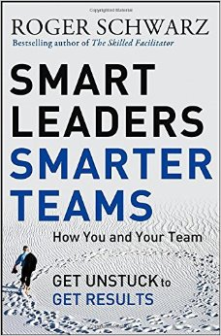
Want to know more?
London Action Science Meetup Group
http://www.meetup.com/London-Action-Science-Meetup/
Eight Behaviours for Smarter Teams (free download):
http://www.schwarzassociates.com/resources/articles/
Smart Leaders Smarter Teams by Roger Schwarz
More about Action Science:
http://www.actionscience.com/actinq.htm
Amy Cuddy's Power Pose Ted talk
https://www.ted.com/talks/amy_cuddy_your_body_language_shapes_who_you_are

Slide 20
Joyful Work
To do make work joyful
As aspiring leaders
We need to practice personal leadership.
Success Criteria
[ ] I know what the Mutual Learning Model is
[ ] I know what the 8 behaviours are
[ ] I’ve gained one or more personal insights
[ ] I've identified at least one personal improvement action
[ ] We've had fun!

Slide 21
Thank you for playing!
Joe Schmetzer
Portia Tung
Renaissance Developer Generalising specialist Coach
Agile Coach Playmaker
Enterprise Gardener
Blog: http://www.exubero.com/
Twitter: tumbarumba
Blog: www.selfishprogramming.org
Twitter: portiatung

Slide 22
Session Schedule
00.00 - 00.03 | Ice breaker and introductions and session goal and criteria
00.03 - 00.05 | Mutual Learning Self-Assessment
00.05 – 00.06 | Prologue
00.06 – 00.11 | Act I, Sc. 1
00.11 – 00.21 | Reflection
00.21 – 00.326 | Model 1 Theory
00.26 – 00.31 | Act I, Sc. 1
00.31 - 00.41 | Reflection
00.41 – 00.51 | Model 2 Theory
00.51 – 00.56 | Mutual Learning Self-Assessment Results
00.56 – 00.59 | Sharing and Improvement Actions
00.59 – 00.62 | Session summary and closing

Slide 23
Appendix
Props for running this session

Slide 24
Materials for Actors
Notes:
Make large wearable nameplates for actors.
Give Values and Assumptions to actors.
Give Behaviours sheet to audience members.
Get observations on results from audience members.

Slide 25
Product Owner Role
You told the development team a release must be ready for the trade show.
You want to win the best product award in 2016.
You have shares in the company.

Slide 26
Project Manager Role
You expect the release to be ready for next week.
You're always right.
You're looking forward to positive recognition for this project.

Slide 27
Team Lead Role
The team haven't made much progress.
You don't want to tell people you're going to miss the agreed deadline because you want to avoid confrontation.

Slide 28
Product Owner
Project Manager
Team Lead
Notes:
Wearable nameplates to make and give to actors.
Why not go hands-free? Just add string so they can put it around their necks.

Slide 29
Act II Scene II
Re-act the scene with some of these assumptions.
I have information; so do other people
Each of us sees things others don’t
People may disagree with me and still have pure motives
Differences are opportunities for learning
I may be contributing to the problem
8 Behaviours from The Virtuous Cycle of Mutual Learning by Roger Schwarz

Slide 30
Act II Scene II
Re-act the scene with some of these behaviours.
State views and ask genuine questions
Share all relevant information
Use specific examples and agree on what important words mean
Explain reasoning and intent
Focus on interests, not positions
Test assumptions and inferences
Jointly design next steps
Discuss undiscussable issues
8 Behaviours from The Virtuous Cycle of Mutual Learning by Roger Schwarz

Slide 31
Materials for Audience

Slide 32
Act I Scene I
Keep a tally of each behaviour each time you see it.
___ State my views without asking for others’ views and vice versa
___ Withhold relevant information
___ Speak in general terms and don’t agree on what important words mean
___ Keep my reasoning private; don’t ask others about their reasoning
___ Focus on positions, not interests
___ Act on untested assumptions and inference as if they were true
___ Control the conversation
___ Avoid, ease into, or save face on difficult issues
8 Behaviours from The Vicious Cycle of Unilateral Control by Roger Schwarz

Slide 33
Act II Scene II
Keep a tally of each behaviour each time you see it.
___ State views and ask genuine questions
___ Share all relevant information
___ Use specific examples and agree on what important words mean
___ Explain reasoning and intent
___ Focus on interests, not positions
___ Test assumptions and inferences
___ Jointly design next steps
___ Discuss undiscussable issues
8 Behaviours from The Virtuous Cycle of Mutual Learning by Roger Schwarz

